Slide 1




Chandigarh University
SENTIMENT ANALYSIS OF ARTICLES
Tushar Lohani (19BCS1559)
Ankit Kumar (19BCS1561)
Sakshi Kumari (19BCS1570)

Slide 2


Table of Contents:
What is Sentiment Analysis?
About the project
Technology Used
How the project works?
Analysis and Results
Future Scope

Slide 3

What is Sentiment Analysis?
It is the use of Natural Language Processing, text analysis, computational linguistics, and biometrics to systematically identify, extract, quantify, and study affective states and subjective information.
It is the most common text classification tool that analyses an incoming message and tells whether the underlying sentiment is positive, negative or neutral.

Slide 4



About the
project
The project deals with the analysis of articles from different fields like –
> Technology
> Books review
> Business
> Entertainment
> Products review
The project gives an analysis whether the selected article is Positive, Negative or Neutral.

Slide 5




Technologies Used
> Python: It is the main part of the project as it is highly used in the project.
> BeautifulSoup: The python library for web scrapping.
> TextBlob: The python library for sentiment analysis.

Slide 6
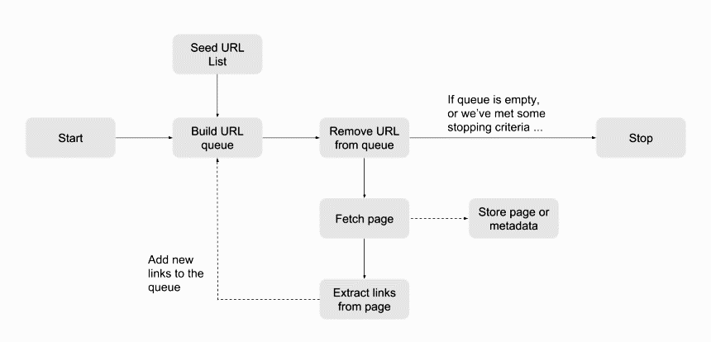
How the project works?
1. First it checks the URL whether it is ACTIVE or INACTIVE.
2. Then it web scraps the specific URL that is selected by the user.

Slide 7

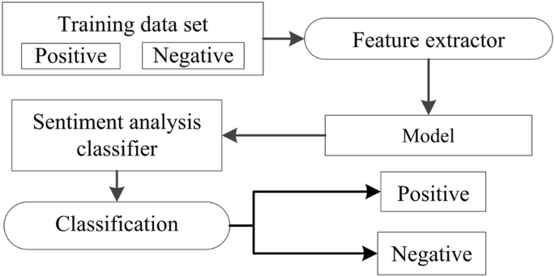
How the project works?
3. Now, the web scrapping of the specific article is done. The algorithm then formats the article where it removes words like the, as, can, will, whose sentiment calculation cannot be done.

Slide 8




How the project works?
4. Now the program finds the polarity of words and assign a point to the word used in the article.
When the polarity is greater than 1
When the polarity is in the range 0 and 0.9.
When the polarity is less than 1
POSITIVE
NEUTRAL
NEGATIVE

Slide 9

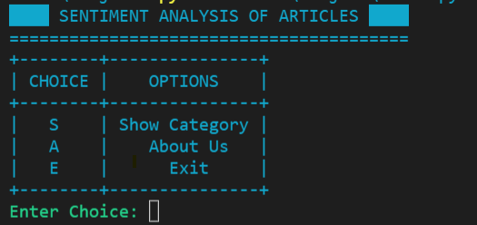
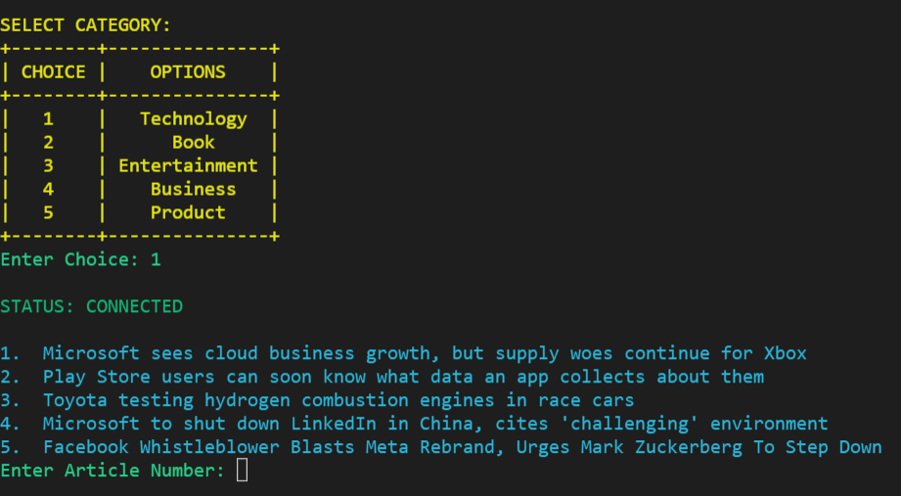

Implementation:

Slide 10
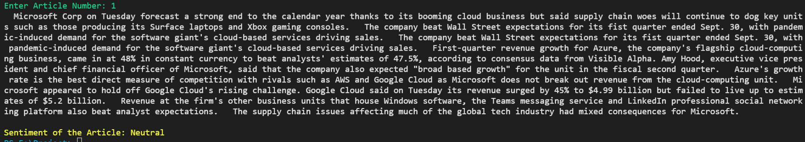
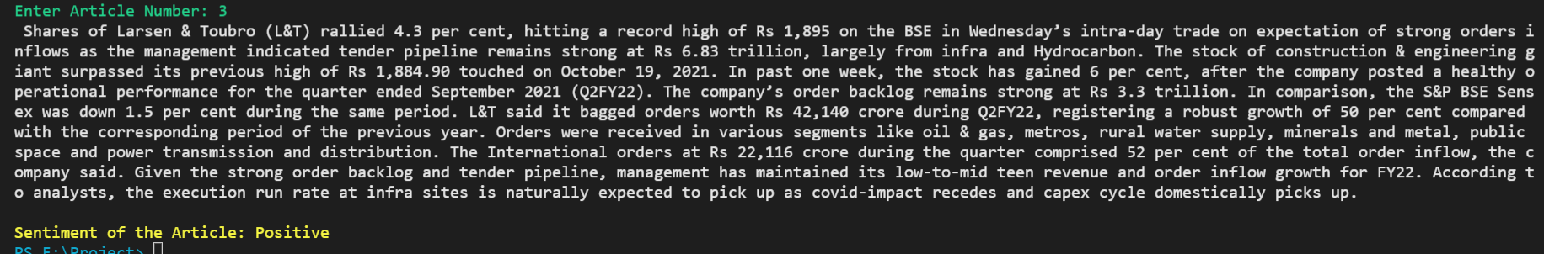
Implementation:

Slide 11
Analysis and Results
The project uses the Naïve Bayes Classifier to find the accuracy of the analysis and results.
On finding the accuracy, we found out the library shows the accuracy of:
83.33%

Slide 12



Future Scope
The project is currently on command based but further it can be in GUI.
The future of Sentiment Analysis is really deep, it can be used to classify the sentiment of image based.
The accuracy to analyze sentiment can be increased by adding more and more dataset to the library.

Slide 13


THANK YOU

